Slide 1
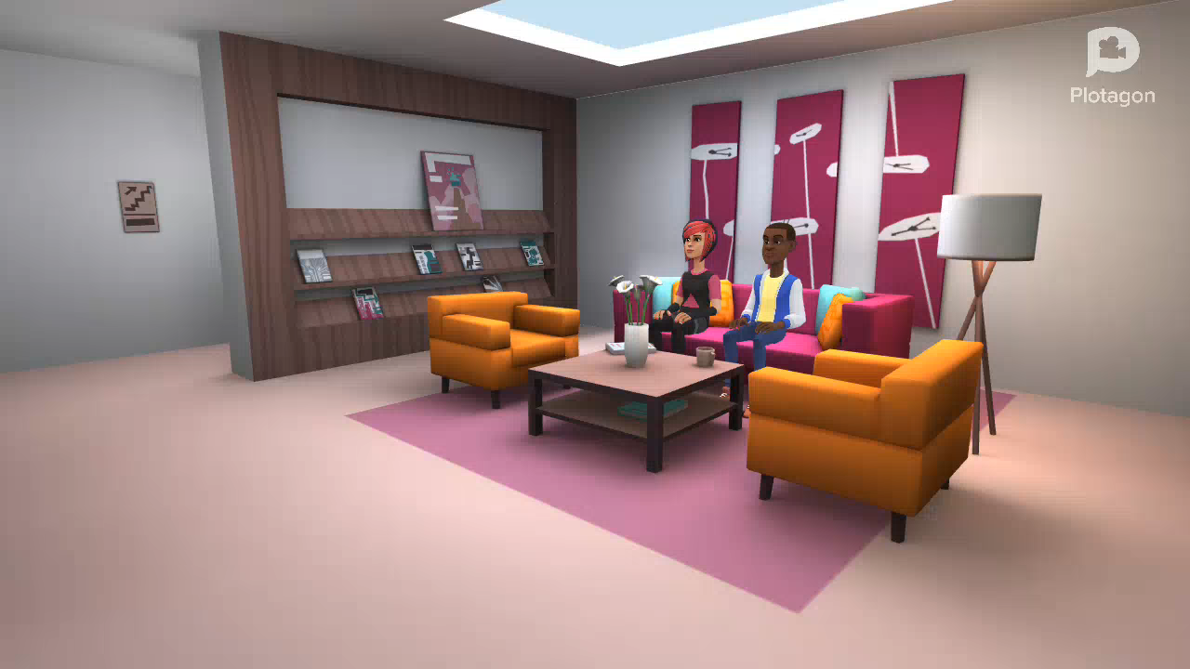

Slide 2

Our story

Slide 3

.
Our belief

Slide 4
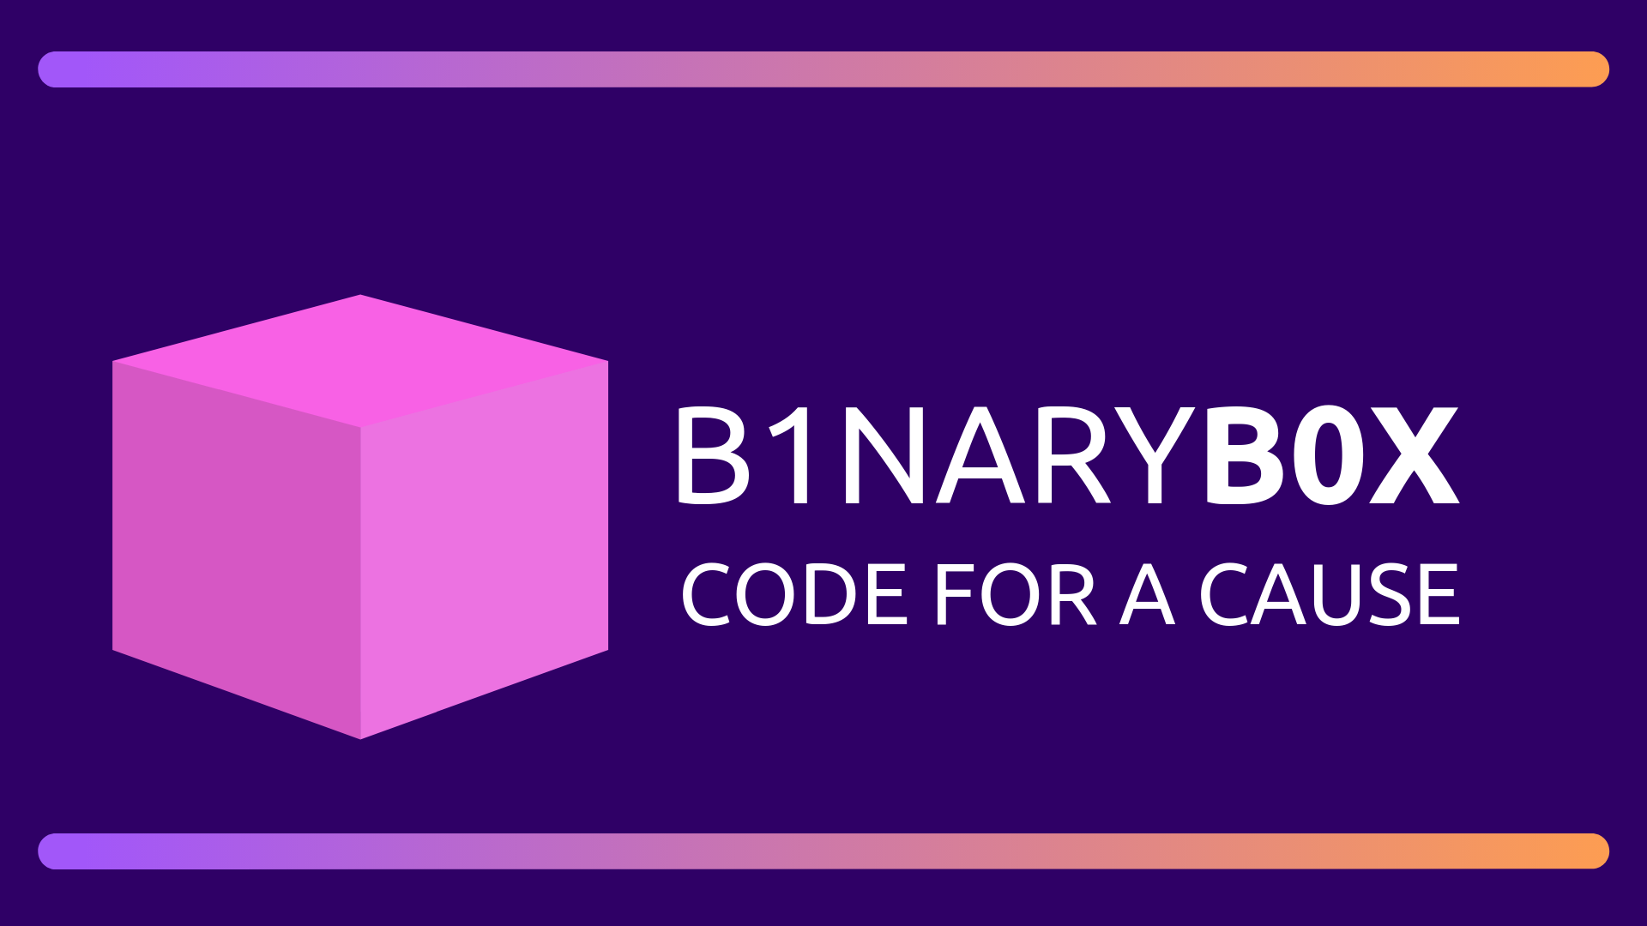

Slide 5
What is the Binary Box?

Slide 6
Here’s what’s inside
the Binary Box

Slide 7

A deeper insight into how we make it happen

Slide 8

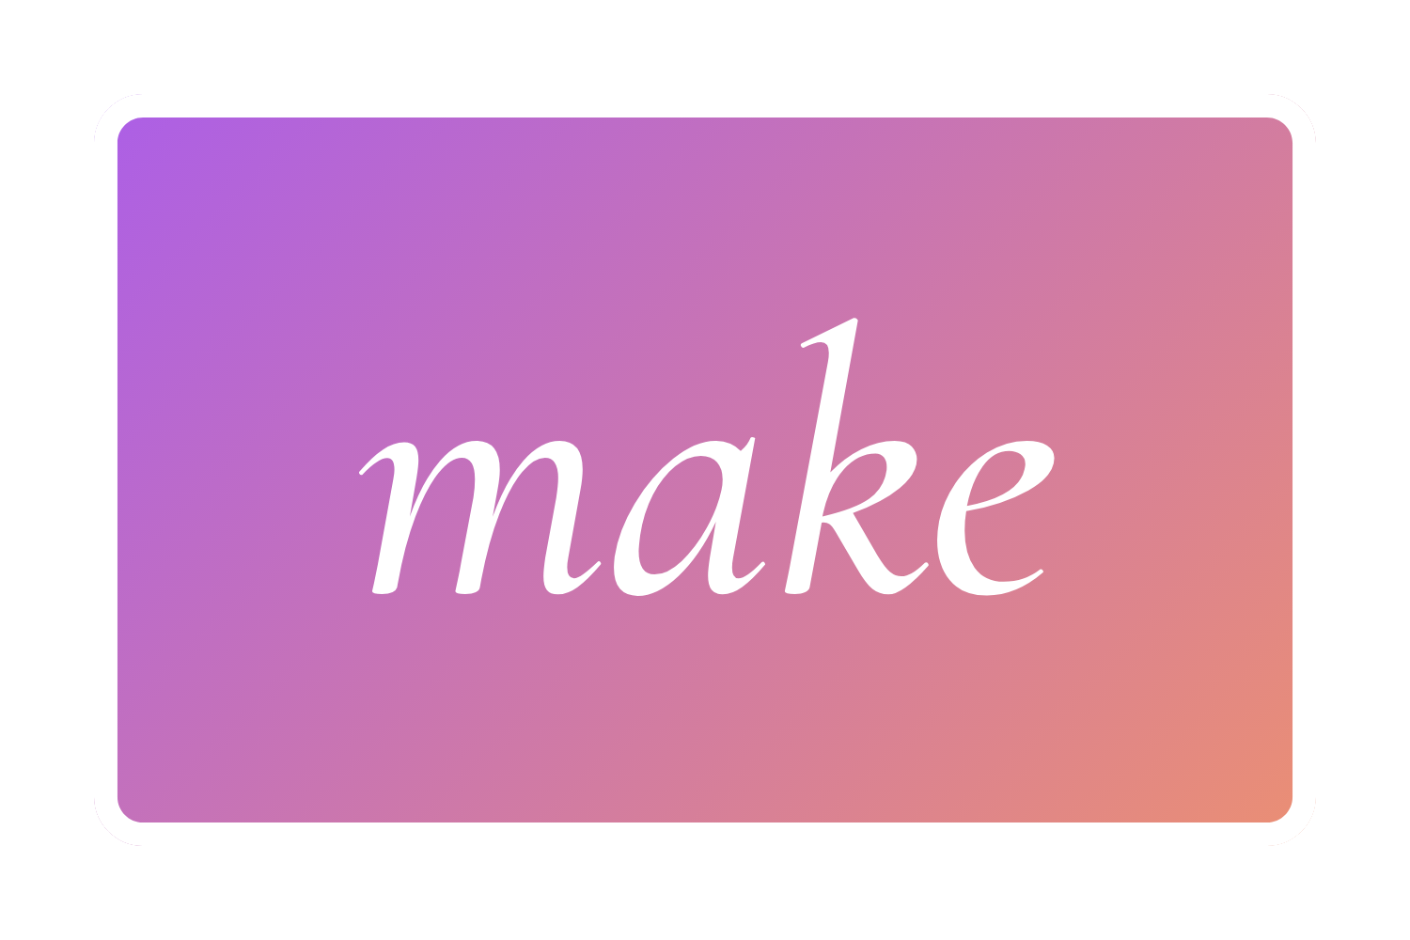

This is why BB is amazing
Learn programming
Make awesome stuff
Develop the planet
Special course content and techniques ensure that you learn
Our kits don’t restrict you, every kit has room for your creativity
Our aim is to develop you into a smart thinking, future imagineer

Slide 9
The BB Privilege Programme

Slide 10
The business model

Slide 11
Competitive study

Slide 12



Vote of thanks
MINET, we love you 3000

